Slide 1
Book1
File created on: 8/09/2019 12:34:20 PM

Slide 2
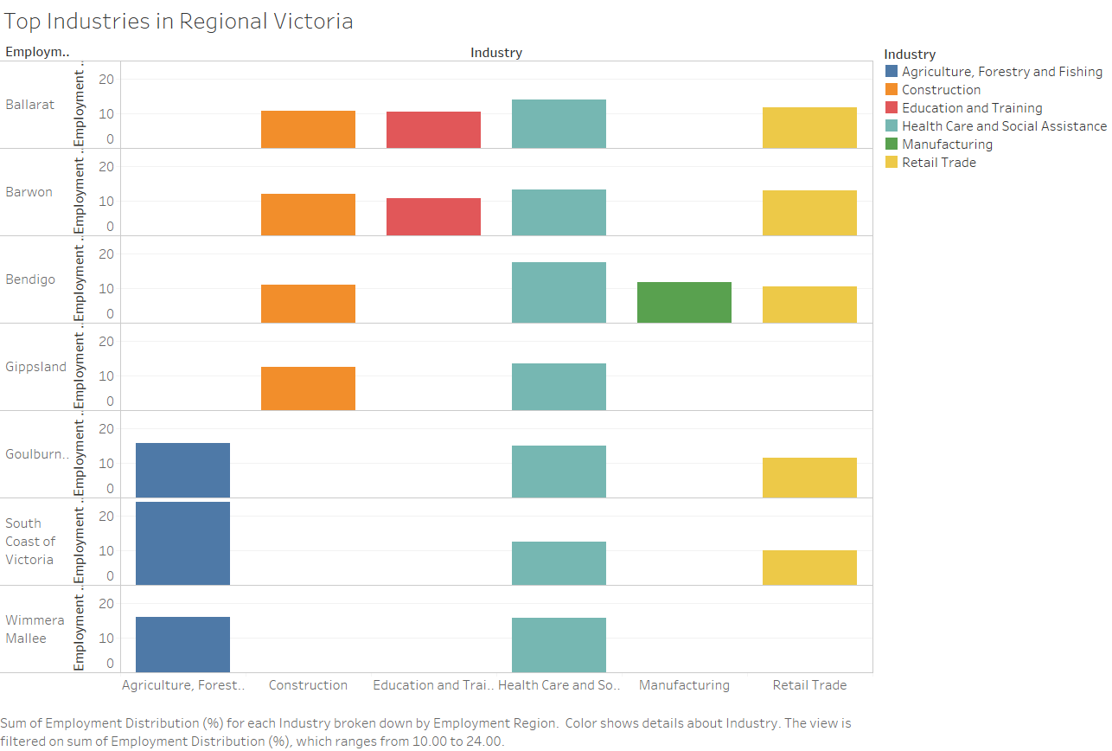
One of the top employment industry is the Health care
and Social assistance industry, which is followed
By the Retail Trade in most of the regional VIC.

Slide 3
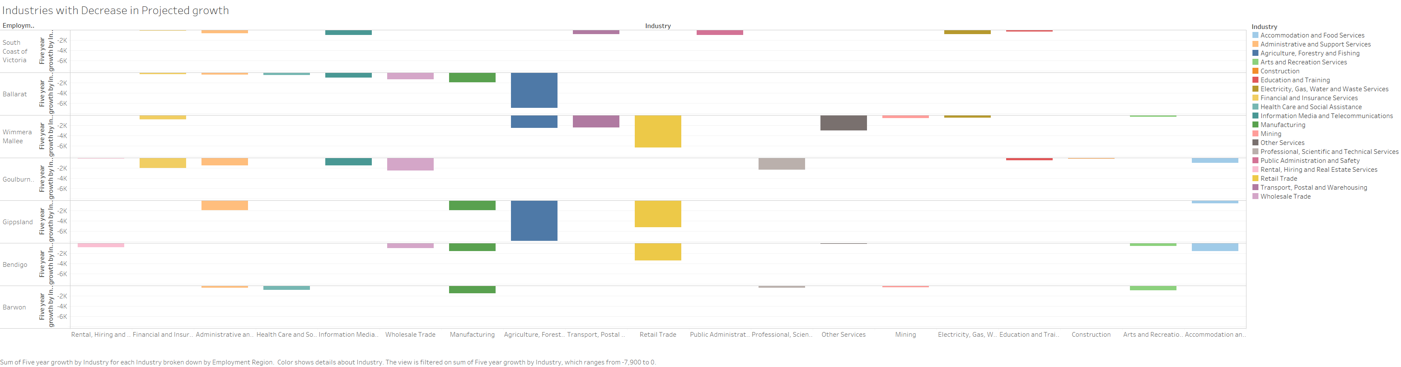
According to the employment projection from the Labour Market Information Portal,
Ballarat, Wimmera-Mallee and Gippsland will have a huge decline in Agriculture, forestry and Fishing employment,along with a decline in retail trade and manufacturing in some regions.

Slide 4
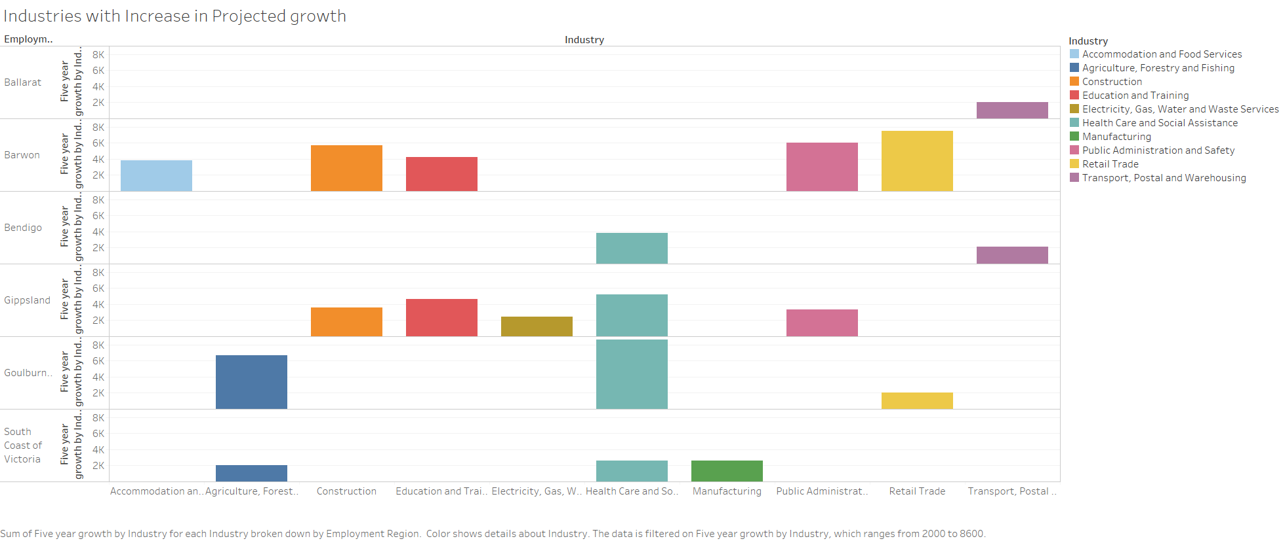
Health care sector will have more employments in future and agriculture sector seems to provide more employment in South coast
Victoria and Goulburn. Interesting fact is there is not much major expected growth by industries in Ballarat.
This is something the Local council should look into.

Slide 5
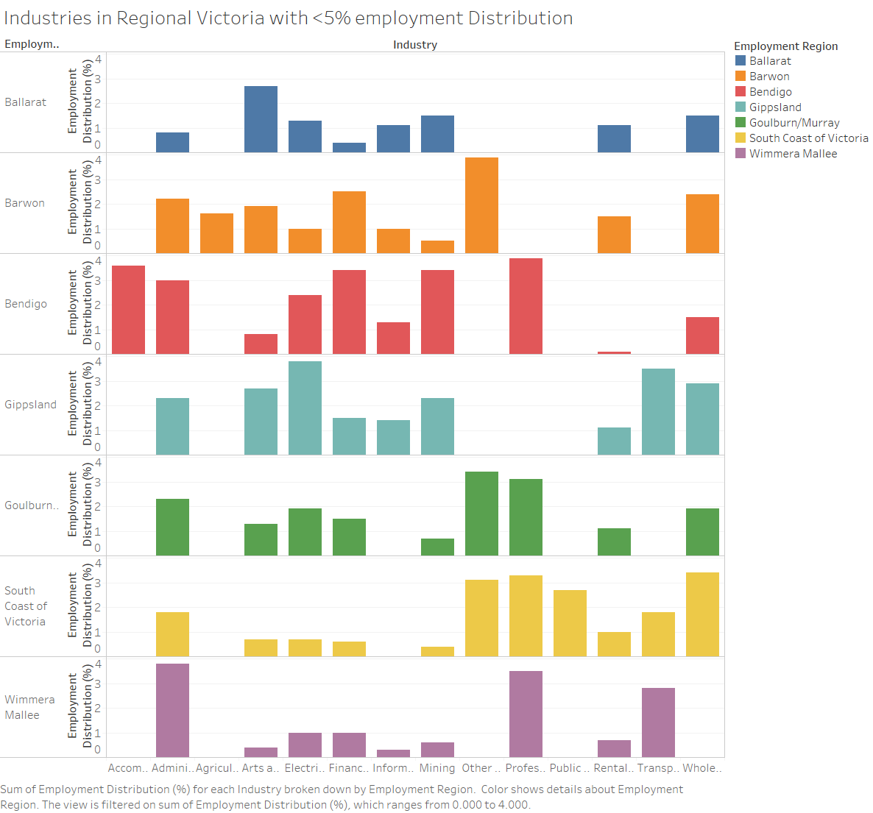

Slide 6
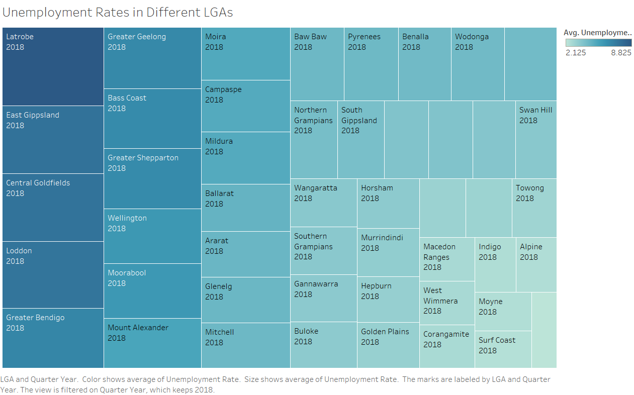

Slide 7
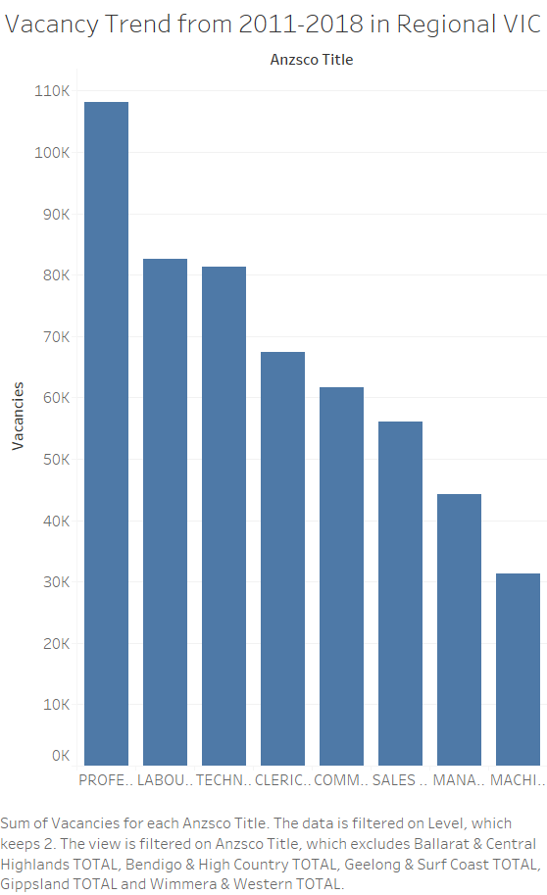

Slide 8
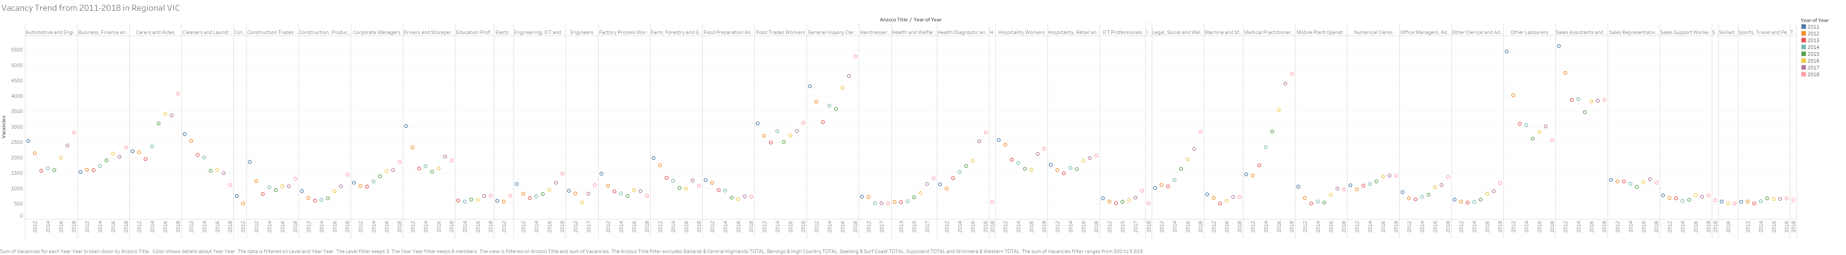
Vacancy Trend from 2011 to 2018 shows that the demand for carers and Aides , and Legal, Welfare and Social Professionals doubled in regional areas and for Medical Practitioners
and Nurses the job demands tripled. Also, there is a decrease in cleaners and Laundry workers and the demand
for sales assistants and salespersons also got decreased over the period. Vacancies for Educational professionals are slightly increasing every year and since there is an expected growth in education and Training industry, probably there will be an increase in demand for employers.

Slide 9
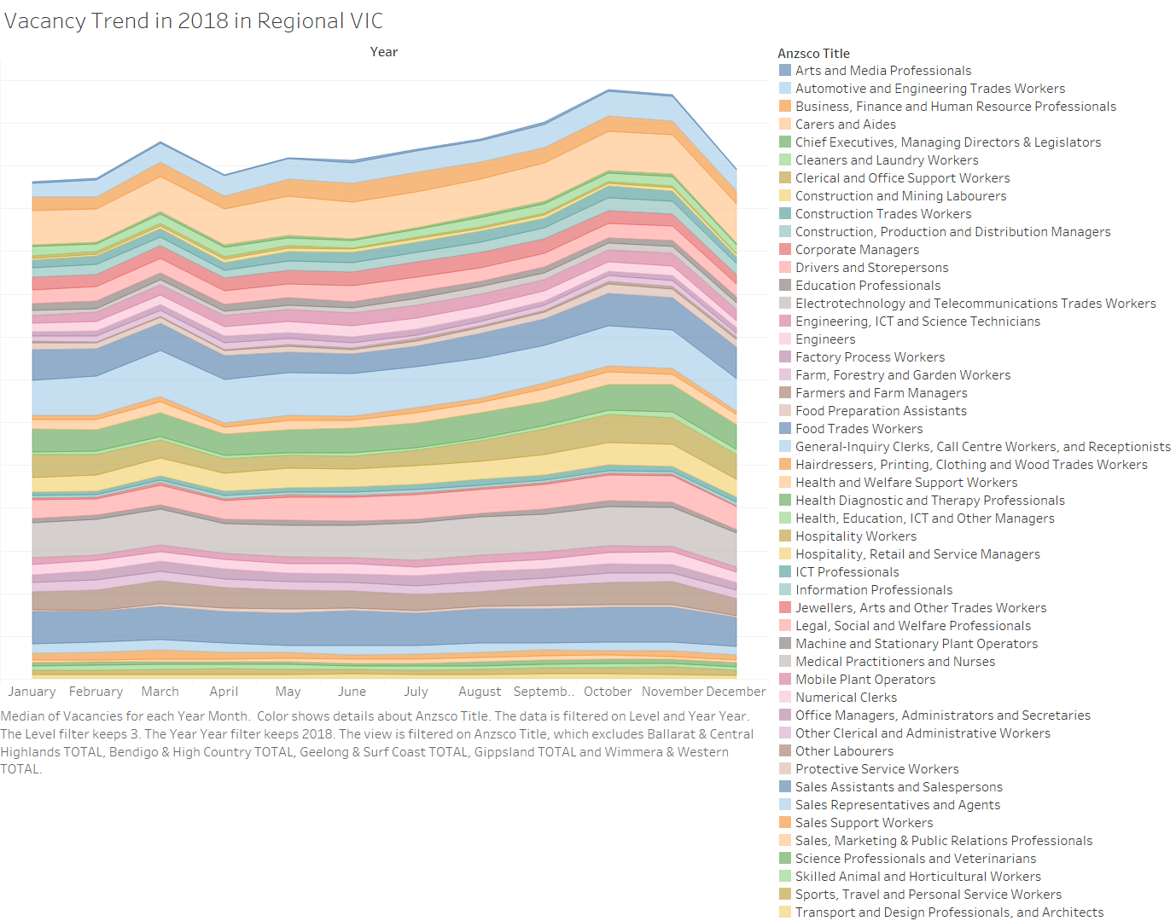
From the Vacancy trend we also
identified the vacancies for each occupations
are posted mostly during March and October.
Those who are looking for employment they should concentrate more on these months.

Slide 10
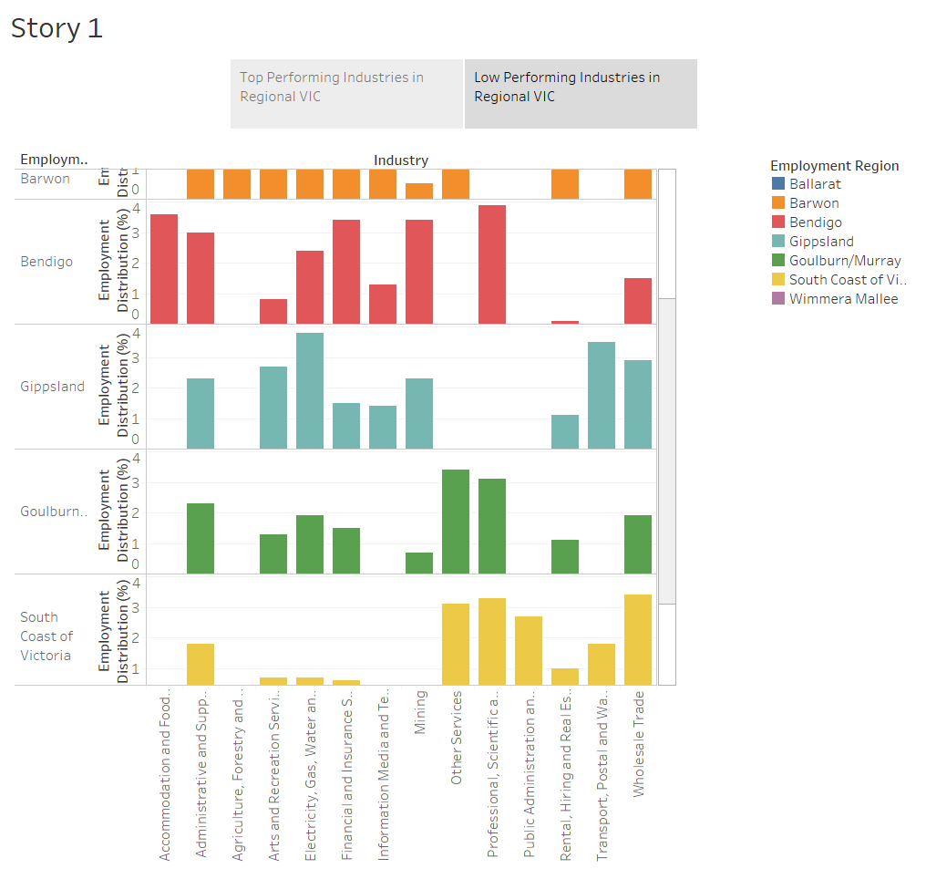

Slide 11
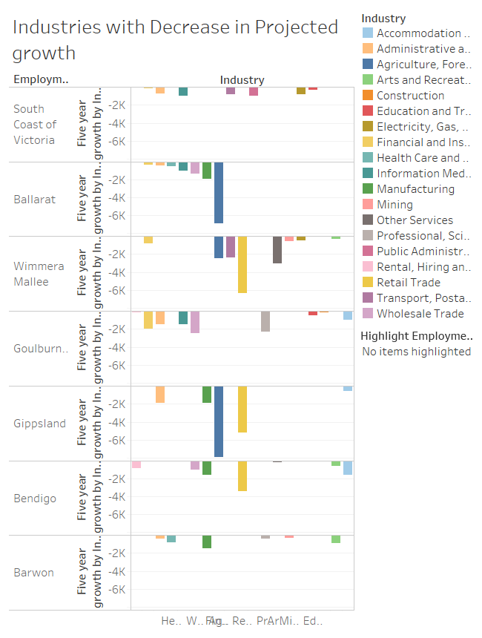

Slide 12
